Slide 1
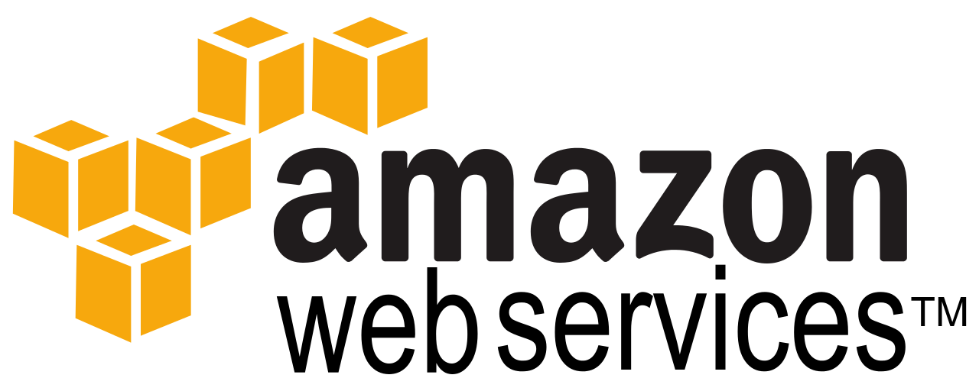
Amazon Web Services:
Infrastructure in a few clicks
Travis Carlson
http://tcarlson.systems

Slide 2
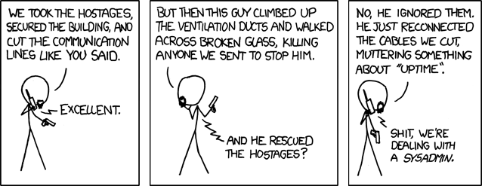

Slide 3

About the presenter
Systems Architect for a small startup
Application Integration specialist
Back-end Java Developer
SysAdmin poser
No affiliation with Amazon!
http://www.urbandictionary.com/define.php?term=poser

Slide 4
Who is IaaS for?
Why should a developer care?
Startups/SMBs
Proof of Concepts
Agile teams blocked by bureaucracy
Elastic map-reduce style jobs
Side/personal projects
etc...

Slide 5
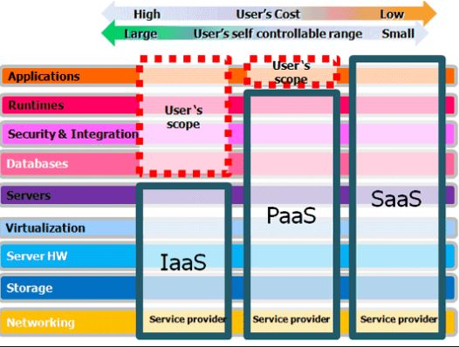
The cloud infrastructure stack
http://www.itsmonkie.co.uk/choose-saas-paas-iaas-premise/

Slide 6
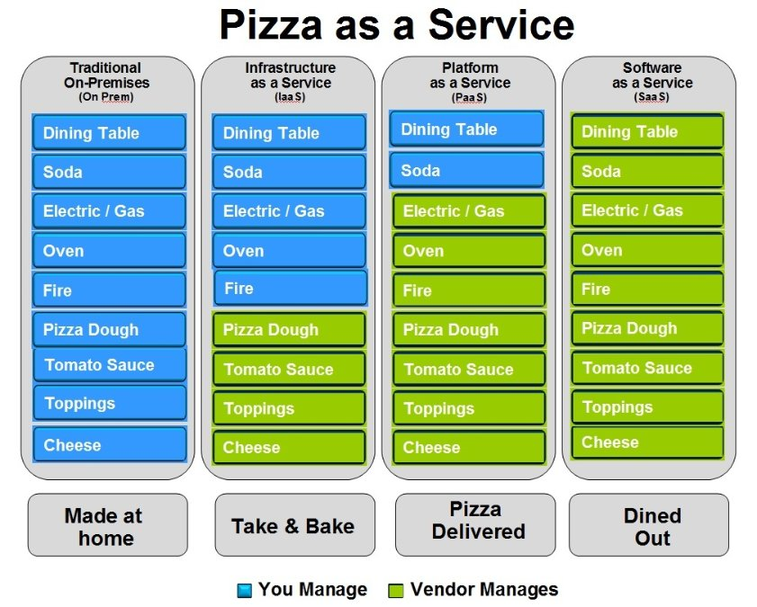
https://www.linkedin.com/pulse/20140730172610-9679881-pizza-as-a-service

Slide 7
Where does AWS fit into the stack?

Slide 8
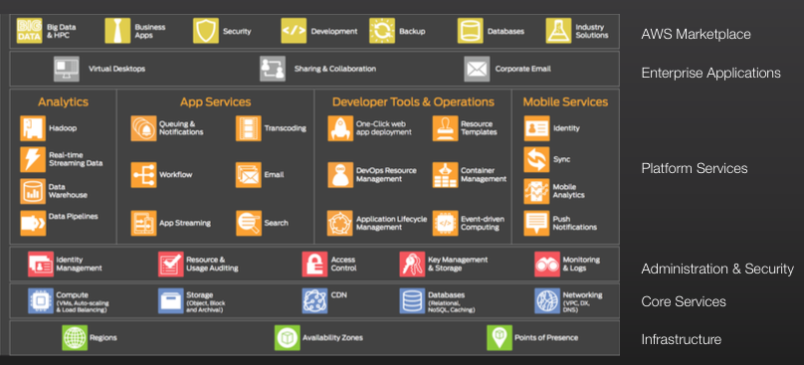
Anywhere you want!

Slide 9
The Essentials
EC2 - server
RDS - relational database
CloudWatch - monitoring

Slide 10
Going further
S3 - Cheap, reliable storage
Glaciar - Even cheaper S3 storage
CloudFront - CDN
DynamoDB - NoSQL database
ElastiCache - Memcached service
SQS - Message queues
SES - E-mail service

Slide 11


Slide 12
EC2 Demo
Create instance
Create database
Connect + install web server, test database
Set up monitors/alerts
Backup server + database
Restore + scale up instance
Command line operations

Slide 13
Basic EC2 Concepts
AMI (Virtual Machine Image)
Instance Type - vCPUs
EBS (Storage Volumes)
VPC (Network security)
Elastic IP

Slide 14
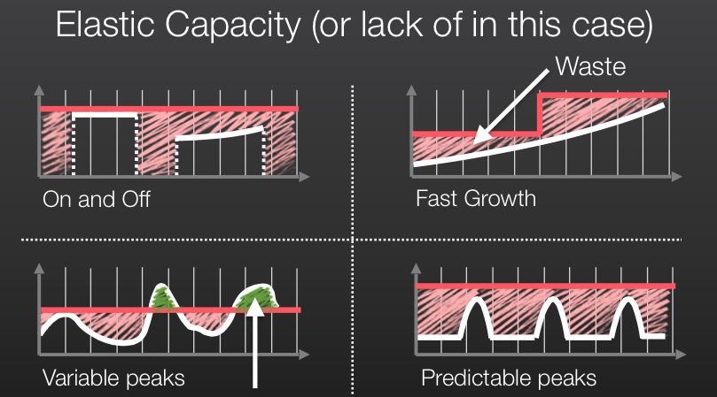

Slide 15
EC2 Advanced
Load Balancer
Auto Scaling
CloudFormation / OpsWorks (Configuation automation)
Container Service (Docker)
Private Cloud VPN<->VPC

Slide 16


